Slide 1

Forensic Psychiatry:
Madness, Murder and Medicine
Dr Nicholas Taylor MB ChB MRCPsych LLM
Consultant Forensic Psychiatrist
Notes:
Thank you for the introduction
I want to talk to you about forensic psychiatry, framed by three concepts – madness, murder and medicine. I’m going to talk about the origins of madness, or one type of madness, how this can lead to behaviour change, taking the example of murder, and then the role that medicine plays in the management of people in this situation.

Slide 2

My journey into Forensic Psychiatry
Bristol University – Nightline
Medicine & Surgery
Submarine Medical Officer
Accident & Emergency
Psychiatry
Forensic Psychiatry
Notes:
HMS Turbulent

Slide 3

drnicholastaylor.me/today
All the slides
A full transcript of the talk
Video of the talk
Information about training in medicine/psychiatry

Slide 4

Notes:
Who are you? What stage are you at? What are your interests in this area – or your career intentions?
Any areas to cover or to avoid?
Are there any mental health professionals here? Psychologist(s)?

Slide 5
Forensic psychiatry
Medicine – psychiatry
Assessment & treatment – MDOs
Prisons, secure hospitals elsewhere
Medicine-law interface
Notes:
Many forensic psychiatrists have qualifications/degrees in both medicine and law

Slide 6
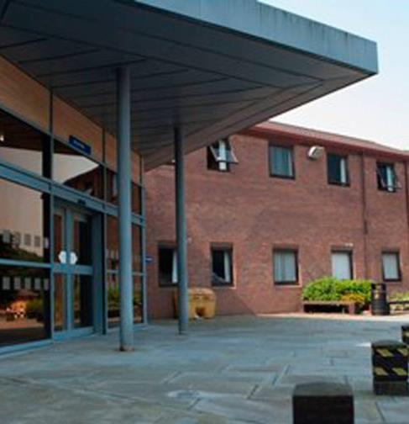
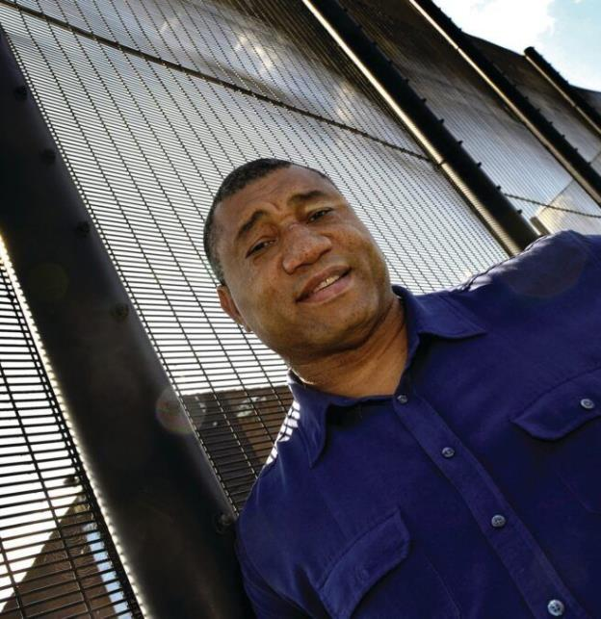

Arnold Lodge
Notes:
NHS Hospital – but secure
Patients, not prisoners, bedrooms not cells
Big fence – 5.2m
Frank

Slide 7
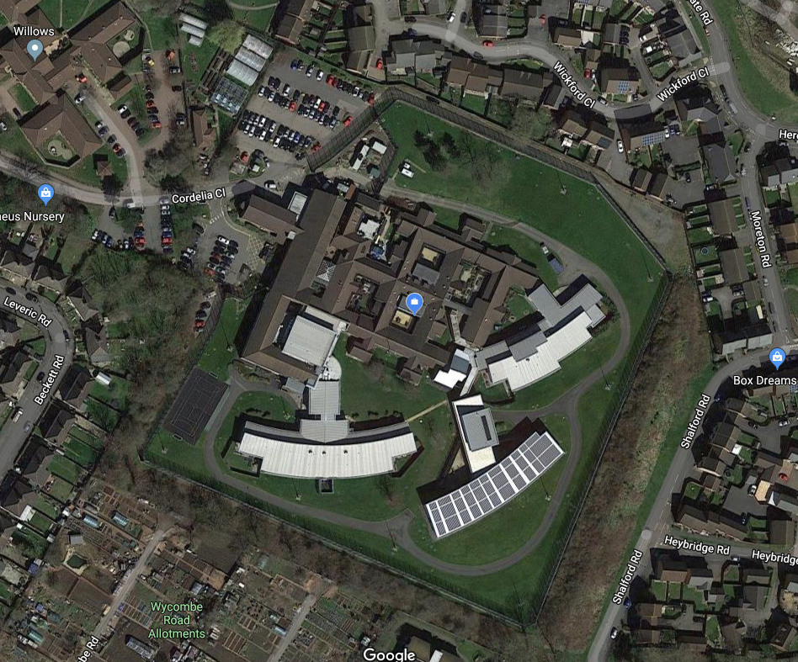
Notes:
Arnold Lodge on Google maps

Slide 8
Outline – will talk about
Madness
Neurosis vs Psychosis
Murder
A typical patient
Medicine
Multidisciplinary treatment
Psychopharmacology
Psychopathology
Neurochemistry
Notes:
Neuro vs psycho – brain vs mind
Neurology vs. Psychiatry

Slide 9

Notes:
Psyche – soul or breath of life
Statue of cupid and psyche – 150AD

Slide 10
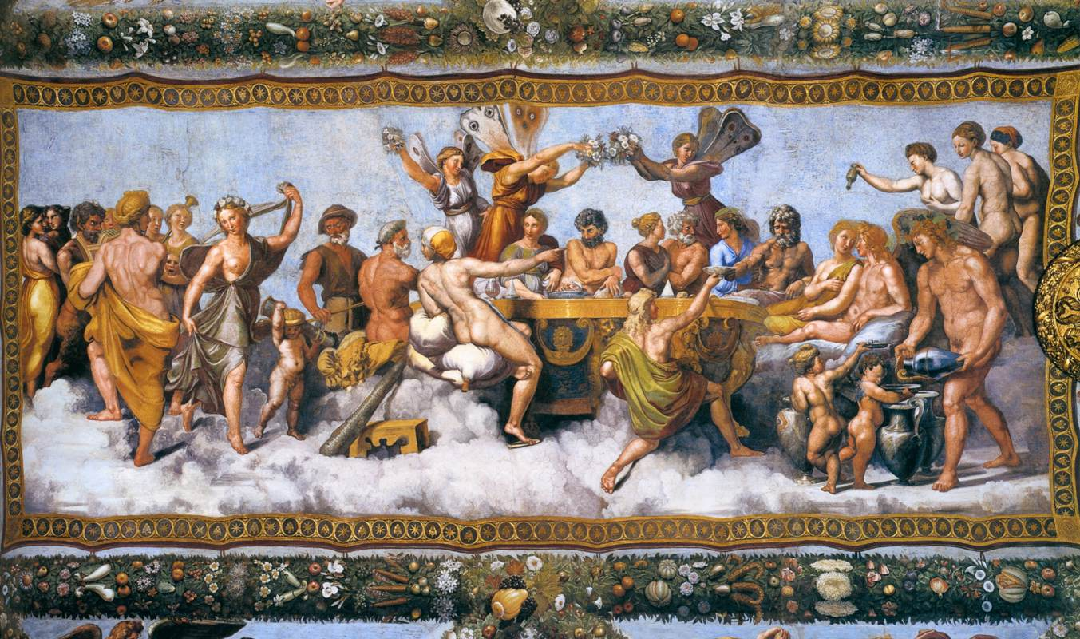
Notes:
Wedding banquet of Cupid and Psyche by Raphael

Slide 11


Slide 12
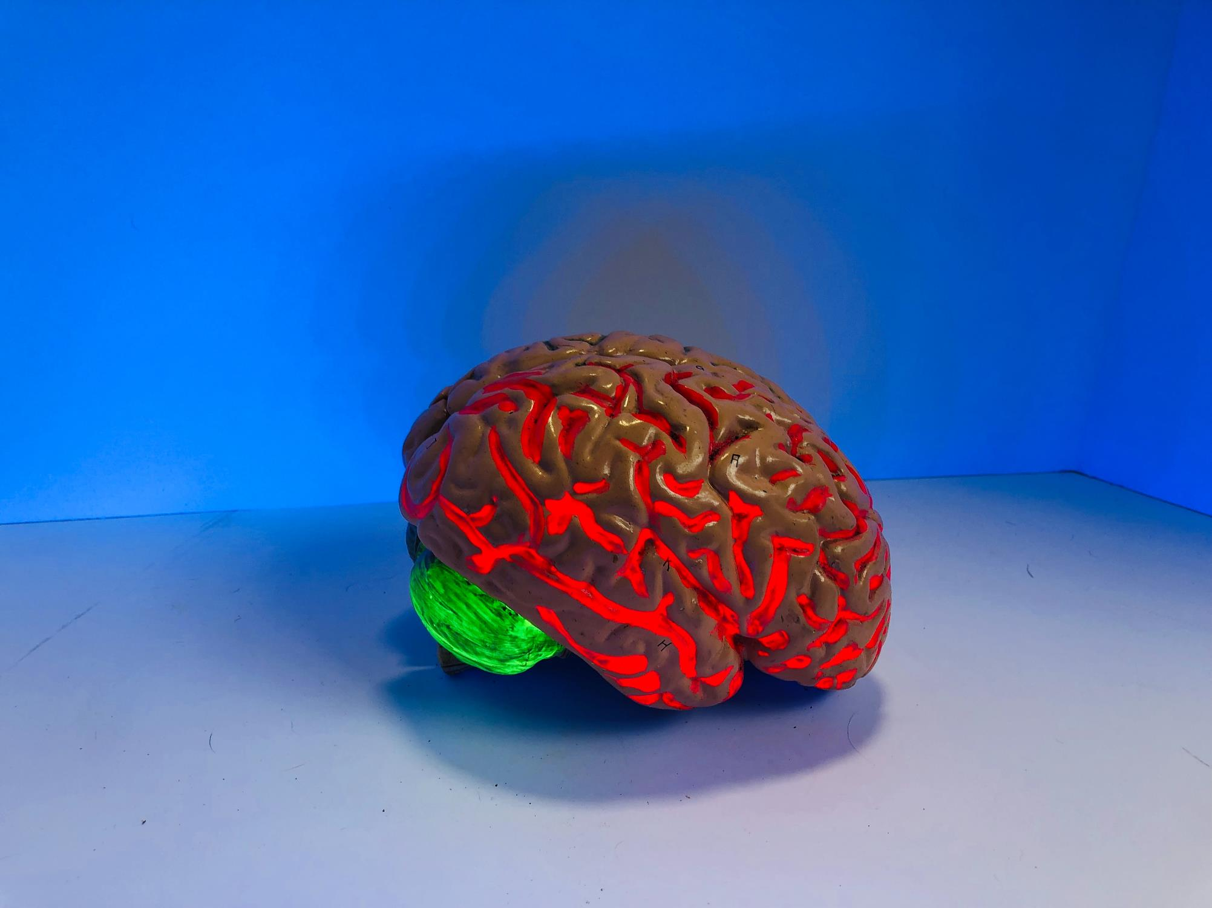
Madness – Neurosis vs Psychosis

Slide 13
Neurosis
Something you’re all familiar with
How anxious people are
Normal range – relaxed to highly anxious
The more neurotic you are, the more you feel worry and anxiety
Notes:
Already familiar – related to anxiety, how easily stressed you are
There’s normal range from laid back to very anxious

Slide 14
Spectrum of neurosis
Mental illness – OCD, depression, anxiety, agoraphobia
Social anxiety, simple phobias
Easily stressed
Relaxed and happy

Slide 15
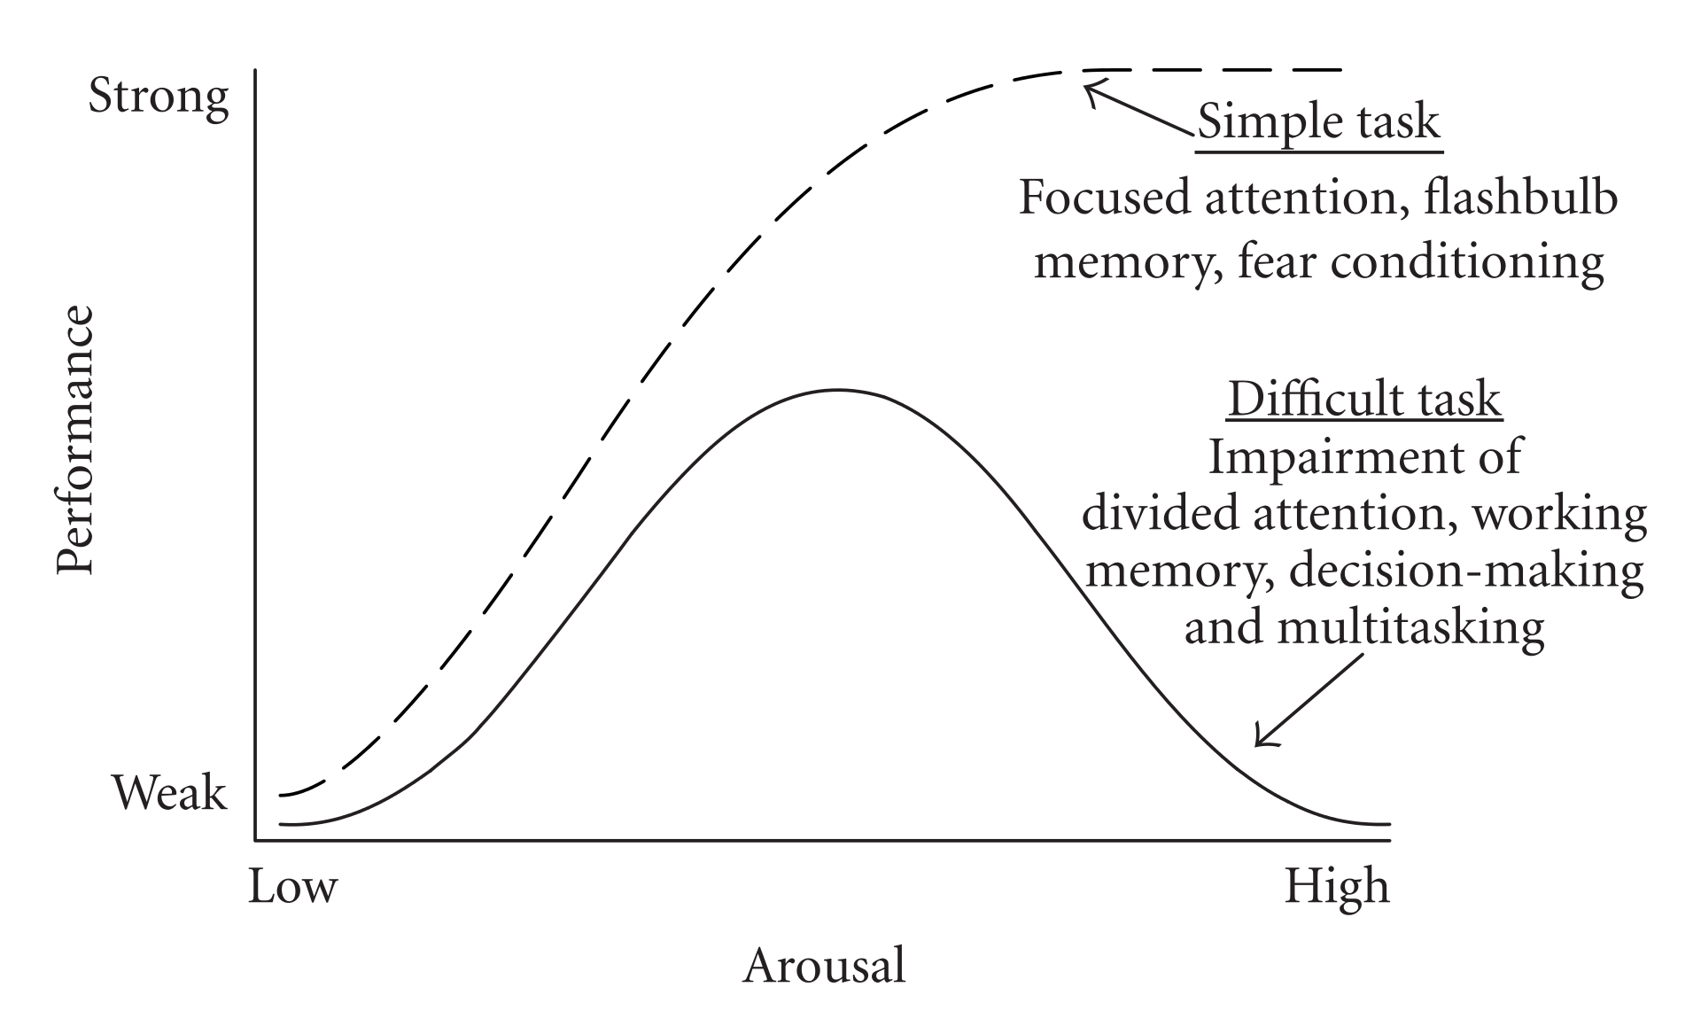
Notes:
People alter their levels of anxiety
Caffeine increases anxiety temporarily
Alcohol and cannabis decrease anxiety – but so does exercise, being with friends, having an early night
Part of development – especially during the teenage years, is learning about your own level of neurosis and learning how to manage it It will be with you for the rest of your life so you might as well get used to it.. Alcohol and cannabis are a bad idea not just because artificial but also because damage developing neurones. There’s a video on my website about this and it’s worth a look.
https://www.youtube.com/watch?time_continue=255&v=g2gVzVIBc_g&feature=emb_logo
A key feature of neurosis is that you always know what’s going on, it’s just that it’s unpleasant.

Slide 16
Psychosis
A severe mental disorder involving loss of the ability to differentiate what’s real and what’s not real
Results from use of (some) drugs and from some mental illnesses
Includes:
Hallucinations
Delusions
Thought disorder
Notes:
Psychosis is different
It is not part of normal human experience and indicates a serious problem
There’s no range from normal to abnormal – you’re either psychotic or you’re not

Slide 17
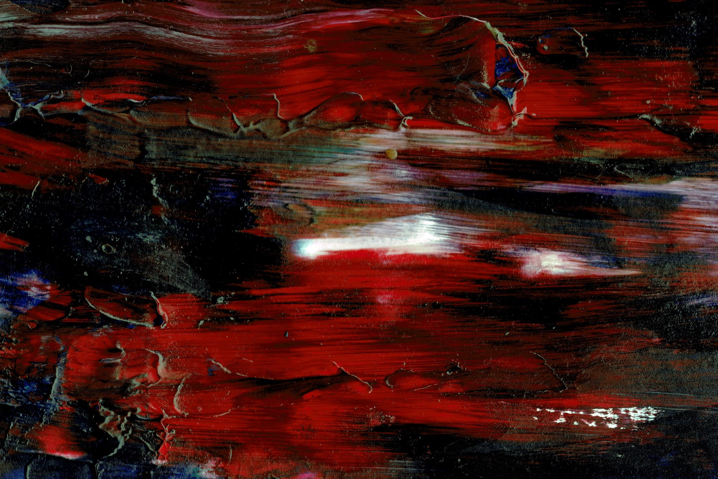
Hallucinations – disorders of perception
Sensory experiences that are perceived as real but which originate within the mind
  Auditory
  Visual – usually organic
  Haptic hallucinations
    Tactile
    Somatic
  Olfactory

Slide 18

Delusions – disorders of belief
A fixed, false belief which persists despite evidence to the contrary and which is not culturally appropriate
Notes:
Capgras’ syndrome – someone replaced by an impostor
Fregoli syndrome – stranger is actually someone familiar

Slide 19

Thought disorder
Disorders of thought possession
  Thought withdrawal
  Thought insertion
  Thought blocking
Disorder of the form of thought
  Knight’s move thinking
  Over-inclusive thinking
  Loosening of associations
  Word salad
Notes:
Now we know how psychosis manifests itself, what are the causes

Slide 20
PSYCHOSIS
Can result from illicit drugs (cannabis, spice, mamba, amphetamines, LSD, cocaine, etc.)
At Arnold Lodge, usually the result of schizophrenia, but also bipolar affective disorder (BPAD)
Notes:
Cannabis use – increases risk of SZP x6

Slide 21
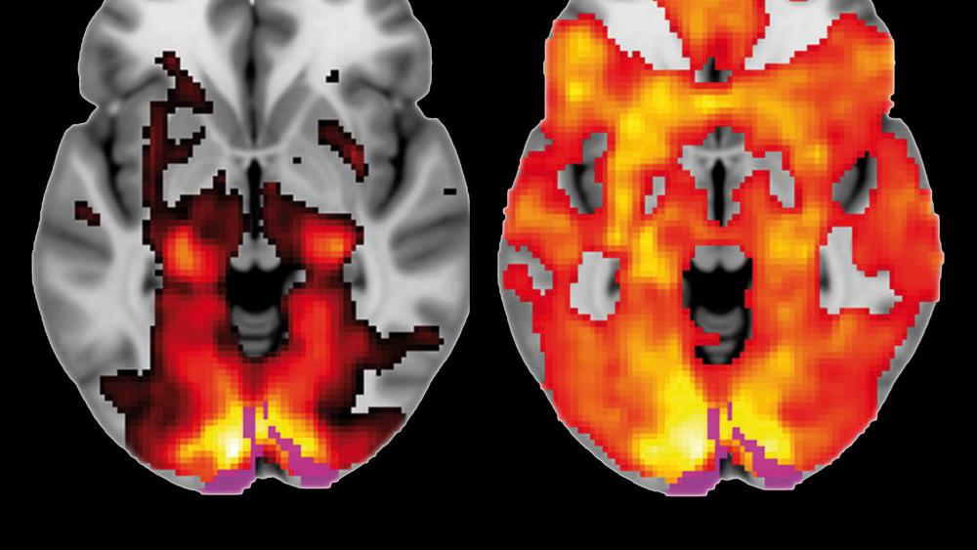

Slide 22
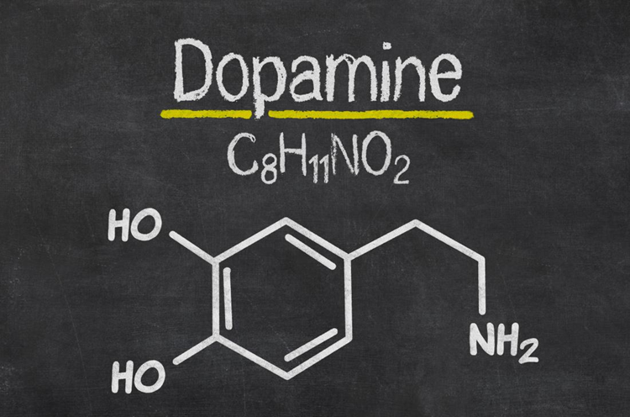
Drugs causing psychosis act through an increase in dopamine in the brain
Notes:
What’s DA?
It’s a neurotransmitter
What do neurotransmitters do? Transmit impulses between neurones in the brain

Slide 23
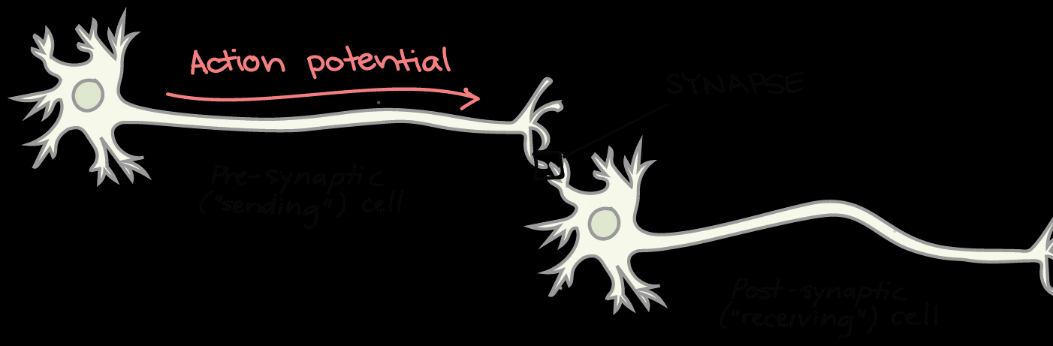
Synapse
Meeting point between two neurones
Notes:
As some of you will know, nerve cells, neurones, transmit messages (action potentials) from one to another. The nerve cells depolarise, meaning that channels open in their walls allowing positively charged sodium ions to rush in. The positive charge reduces the negative charge the neurones normally have and the normally negatively charged cell membrane becomes positively charged. This propagates down the cell – along the long thin axon – to the axon terminal – where it meets the next cell on the other side of a gap called the synapse – the junction between the cells. I want to focus on the synapse because this is where it all happens – and where madness manifests itself.
The diagram here is a simplification – one neurone doesn’t interact with one downstream neurone.

Slide 24
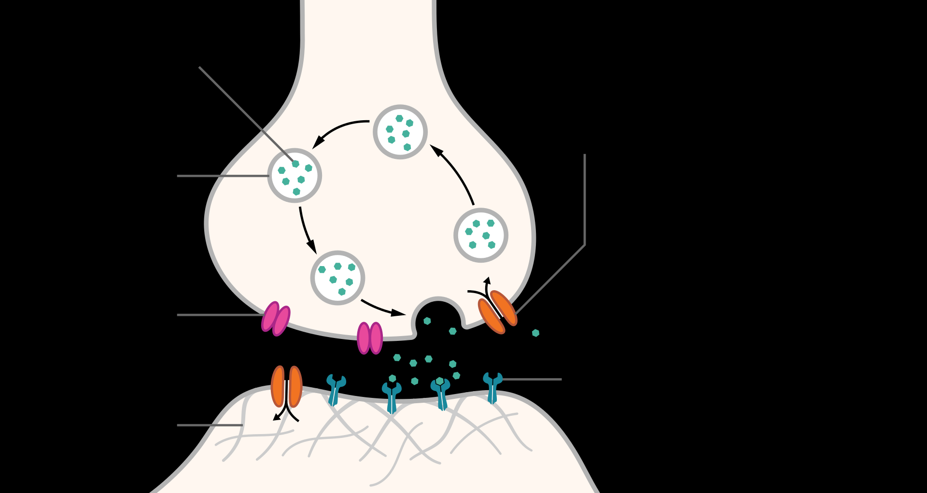
Notes:
They communicate by action potential is moving along with the cell what happens when the action potential reaches the end of the Cell?
When the action potential reaches the end of the axon, it reaches a wider part of the cell and the depolarisation can’t proceed as before.
When it reaches the end of the cell it has an effect on small vesicles in the cell containing messenger molecules – in our case dopamine. The AP causes the vesicle to merge with the cell membrane in the synapse and release its contents (dopamine) into the synapse.
CARRY ON HERE!

Slide 25

How many synapses?
100-1000 trillion
100,000,000,000,000 - 1000,000,000,000,000
Notes:
There are lots of them – so many that there are lots and lots of synapses.

Slide 26
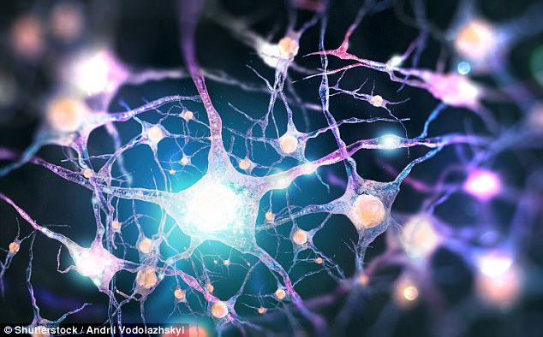
Notes:
In fact, there is a huge web or mesh of neurones, all interacting.
How many neurons are there in this mesh?

Slide 27
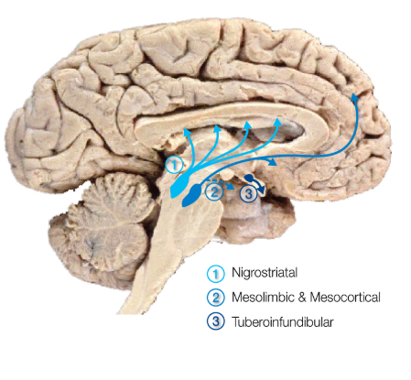
Notes:
Mesolimbic = positive symptoms

Slide 28

A typical story
Notes:
So how does psychosis present in forensic psychiatry.
I think it’s important to say that I’m talking about homicides committed by people because of their mental health problems. This is something much reported in the press which is very, very rare. There are about 50 homicides in the UK every year committed by someone because of their mental health problems and they almost always kill a member of their immediate family. As a member of the public you are more likely to be killed by a police car or an ambulance than you are by a mentally ill person.
A typical pattern
Childhood deprivation – drug & alcohol use in the family, separation, violence & abuse at home
Truanting from school
Early criminality – stealing cars, age 13-14 years – older boys & drug use – solvents age 10, cannabis from 11-12 years, sometimes rapid progression to cocaine & heroin – sometimes just cannabis
Psychosis
Delusions depending on cultural background – black magic, spirits, religious. People possessed by djinns, being subjected to voodoo, are Jesus, are being poisoned by others, having their house taken off them by the council, or someone diverting their post or just talking about them behind their back. Sometimes it’s global conspiracy – aliens, New World Order, Illuminati, reptoids, etc. etc. Other cases – the leaders of a local Mosque are in cahoots with terrorists overseas to have family persecuted, their parents have taken a (delusional) girlfriend hostage and are keeping her locked in a secret room at home. A flatmate is practising witchcraft or is a vampire and is going to kill them.
Voices generally 3rd person – running commentary – not instructions in the 2nd person to hurt, injure, etc. They often link up with the delusions.
Voice of God confirms that you are Jesus, the djinn provides feedback on the black magic
Work colleagues persecuting them.
People generally have persecutory ideas about people they don’t like or who they are forced to come into contact with. They often have arguments at work and suspect their friends of lying to them, poisoning them or causing them trouble.
The hallucinations are distracting and they have trouble concentrating.
Understandably, these people have difficulty concentrating, making friends and working with others. These people soon lose their jobs and lose contact with their circle of friends – they end up at home on their own or – more often – living back with parents in their late 20s or early 30s.
The parents are increasingly concerned about them and want to get help – take them to the GP or to A&E – sometimes tricking them to get them there – saying that the mother has a broken leg and then springing an assessment on the affected person.
Clearly they are paranoid and think people are out to get them – they become suspicious of their parents – they are trying to get me locked in a mental hospital – not to help but to have them killed – or silenced.
Stories in forensic psychiatry always end badly – the very many patients who recover spontaneously or get better with treatment never come to our attention – we only see the ones which end in disaster.
A sad but common results in our patients is that they feel more and more desperate as time goes by and, after losing touch with former colleagues and friends, they end up living with and resenting their parents, feeling more and more anxious about the persecution and using more and more drugs – usually cannabis and alcohol – to try to help them relax. It generally does make them feel more relaxed but also, in the background, increases the paranoia.
Don’t want help with mental health because there’s nothing wrong with them – it’s the fact that people are doing mind control or black magic that’s the problem – not their mental health. Sometimes get admitted to hospital – and leave again – and don’t take tablets.
Family becomes more concerned and more desperate for help – often ringing doctors, etc.
What does the patient think of that? It’s all part of the conspiracy.

Slide 29

Homicide
Notes:
After some time the psychotic person can reach the end of their tether. They have had enough, their patience has been exhausted and they act – sometimes killing a close family member to prevent a hospital admission, sometimes in a belief that it will stop the black magic/voodoo/voices. Sometimes it’s because they think they’re Jesus and will be reincarnated if they carry out the act.
There are a range of reasons and the perpetrator generally feels like they have done the right thing – or necessary thing.

Slide 30

Notes:
Arrested, charged with murder, interviewed by police then taken to prison to protect the public
Prison MH services are worried – call a forensic psychiatrist
I go and see them
Interview – maybe in cell – maybe not! – staying safe
Unwell? I think so – they don’t – transfer to hospital

Slide 31


Slide 32
Arnold Lodge
Notes:
Hospital
Patients, not prisoners, bedrooms not cells
Big fence
Frank

Slide 33
Admission to hospital
Own bedroom
Multidisciplinary team:
  Forensic psychiatrist
  Registered Mental Health Nurses – named nurse/keyworker
  Clinical psychologist
  Occupational therapist
  Social worker
  Support workers
Structured day activities
Educational opportunities

Slide 34
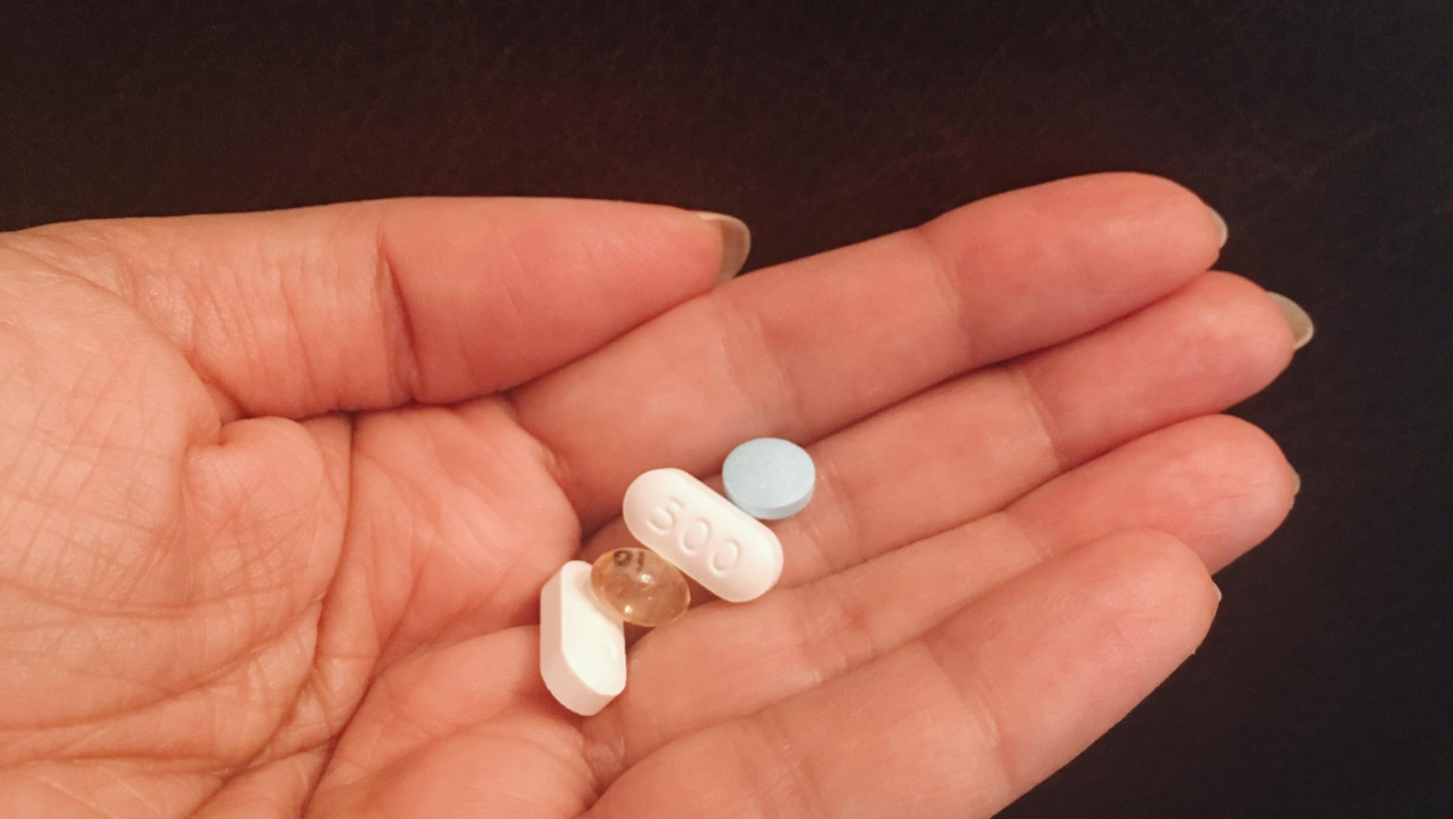

Slide 35
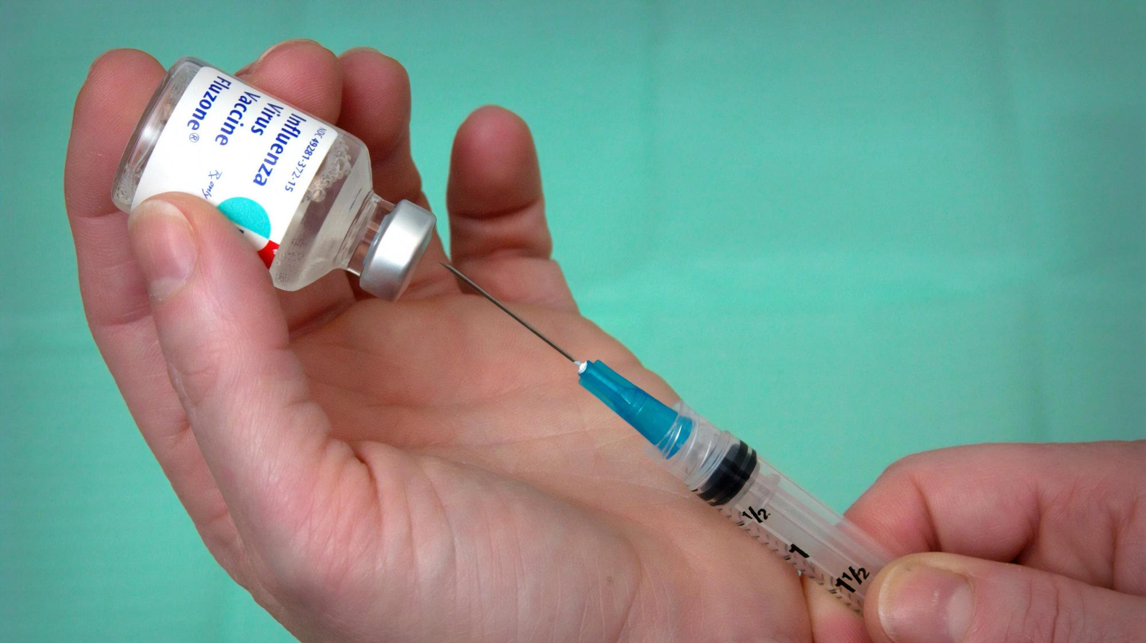

Slide 36
Arnold Lodge
Notes:
Hospital
Patients, not prisoners, bedrooms not cells
Big fence
Frank

Slide 38
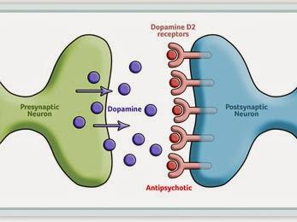

Slide 39
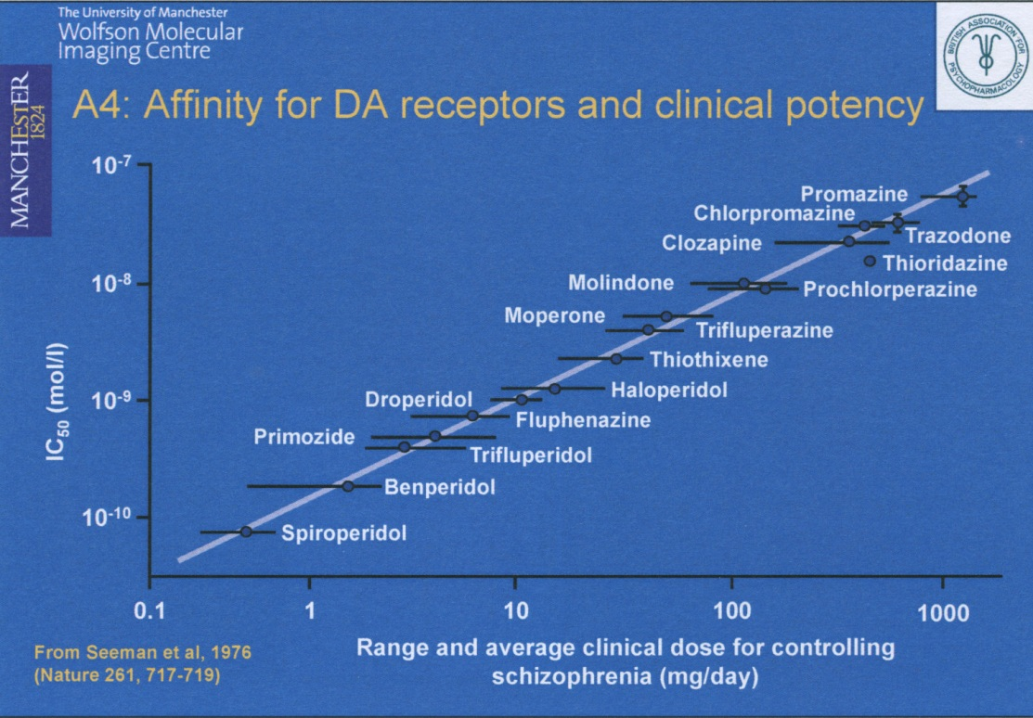

Slide 40
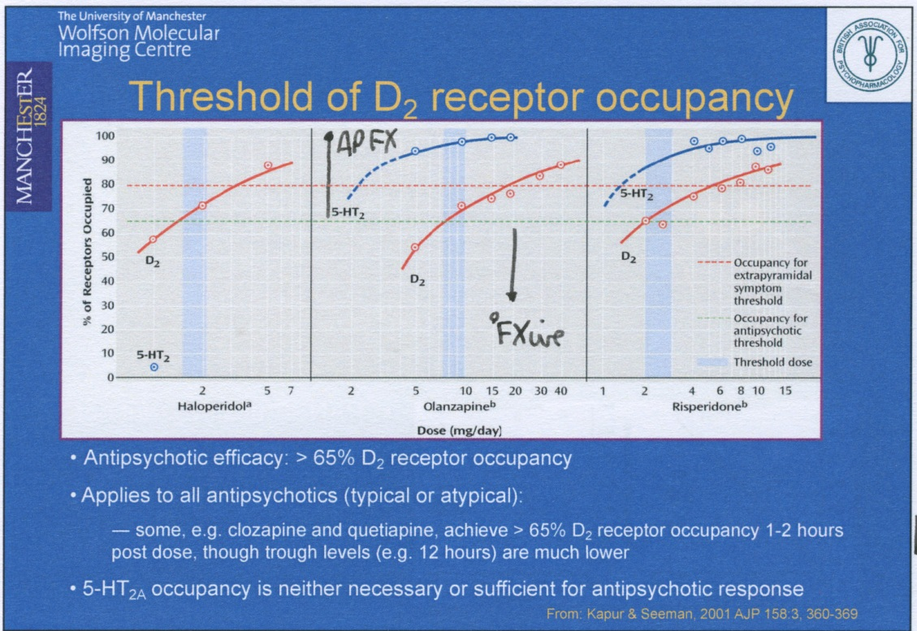
Notes:
Aim for 65-80% occupancy – or effects on the other pathways
Movement problems – Parkinsonism
Prolactin elevation

Slide 41
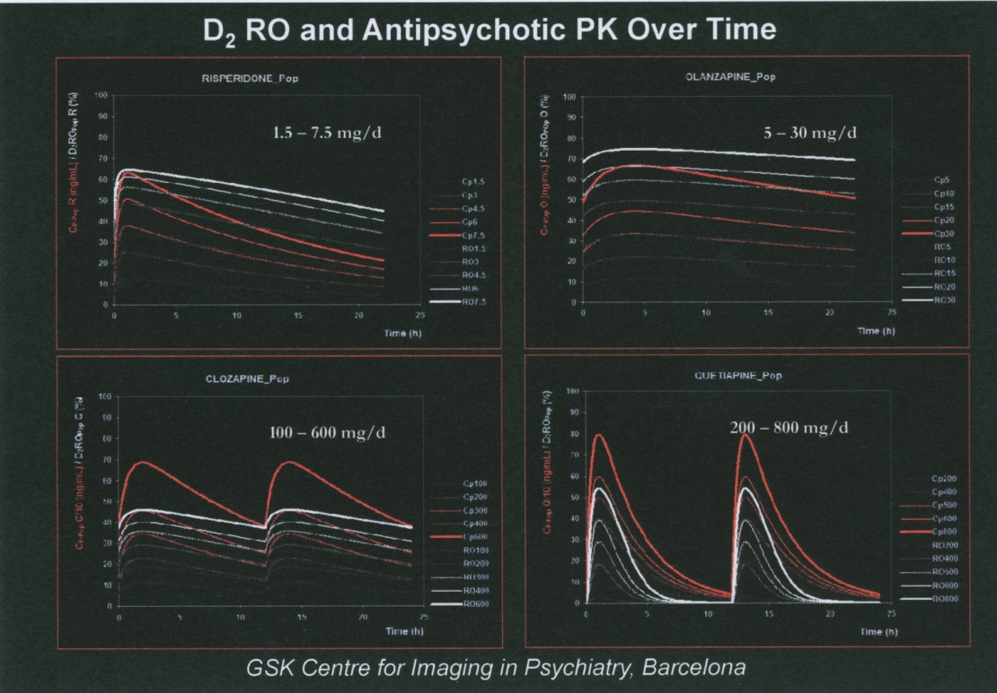
Notes:
Quetiapine should be tds or MR bd (at least)

Slide 42
Success
Right drug, right dose
Supplementary work:
  Mental health awareness
  Substance misuse work
  Violent/Sex Offender Treatment Programme
Gradual rehabilitation
Leave – escorted then unescorted
Return to the community – and employment
Notes:
80% recovery from an individual episode

Slide 43


Slide 44
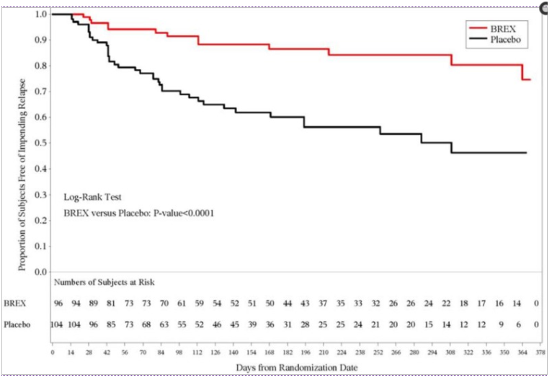

Slide 45
Outline – will talk about
Madness
Neurosis vs Psychosis
Murder
A typical patient
Medicine
Multidisciplinary treatment
Psychopharmacology
Psychopathology
Neurochemistry
Notes:
“We want a great speaker” – do you know anyone?
Neuro vs psycho – brain vs mind
Neurology vs. Psychiatry

Slide 46

drnicholastaylor.me/today

Slide 47

Notes:
Psychology vs psychiatry
Different fields but often work closely together – with a range of other MH professionals
Psychologists – proper doctors – PhD – academic doctors, not doctors of medicine
Work in a range of fields – sports psychologists, educational psychologists, clinical psychologists, forensic psychologists, etc. etc.
I want to use a racing car analogy to explain the difference
Work to assess/test/understand people and usually to help them with a problem of some sort
Educational psychology at Eton – high performance – maybe spoiler adjusted, tyres replaced, broken steering wheel, how fast to take the bends, tactics – how to win the race – don’t drink/use drugs – as well as issues that could lead to something disastrous if not treated – puncture – blowout
Important, significant impact on performance, preventing serious accidents/illnesses – difference between winning the race and losing your life

Slide 48
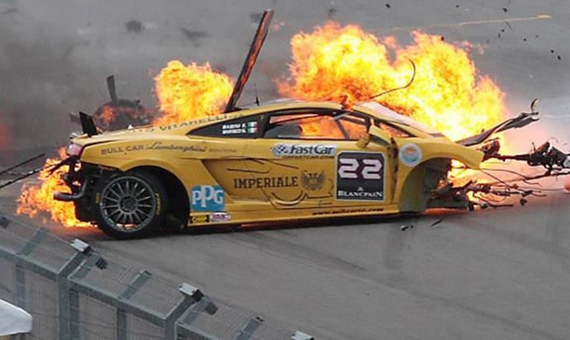
Notes:
Forensic Psychiatry
It’s all gone wrong – maybe because you didn’t work properly with the psychologist (or the NHS didn’t provide you with one)
Spoiler adjustment, a rest, new tyres don’t do the job here
Someone needs to put the fire out, the car needs to be taken away for a long time, taken to pieces and put back together again
Analogy breaks down – we scrap cars if too badly damaged but we don’t scrap people – no matter how badly damaged they are, even if they’re not going to be racing again any time soon. This is often the case with patients in forensic psychiatry. It’s not about getting back to high powered jobs, it’s about keeping the patient alive – and other people alive.

